Slide 1
Federal Update
Kentucky Rural Health Assoc.
Brock Slabach, MPH, FACHE
Senior Vice President for Member Services
National Rural Health Association

Slide 2
Improving the health of the 62 million who call rural America home.
NRHA is non-profit
and non-partisan.

Slide 3
Membership and Foundation
www.ruralhealthweb.org
Join NRHA Today!
Give to our newly formed Foundation

Slide 4
Our Grassroots Effort
NRHA doesn’t have a PAC
Website: ruralhealthweb.org
Depends solely on grassroots advocacy
Members have access to:
Periodic Washington Updates (webinars):
join-grassroots@lists.wisc.edu
Rural Health Blog
http://blog.ruralhealthweb.org
Join NRHA today at ruralhealthweb.org

Slide 5
2013-14 Meetings
RHC/CAH Conference
Austin, TX, Oct. 1-4, 2013
Multi-racial & Multi-cultural Conference
San Antonio, TX, Dec. 4-6, 2013
Policy Institute
Washington, DC, Feb. 4-6, 2014
Annual Conference
Las Vegas, NV, April 22-25, 2014

Slide 6
National Rural Health Association Membership
2012

Slide 7
Status of Rural
62 million rural Americans rely on rural health providers.
20 percent of the population lives in rural America, yet they are scattered over 90% of the landmass.
Extreme distances, challenging geography and weather complicate health care delivery.
“Rural Americans are older, poorer and sicker than their urban counterparts… Rural areas have higher rates of poverty, chronic disease, and uninsured and underinsured, and millions of rural Americans have limited access to a primary care provider.” (HHS, 2011)
Disparities are compounded if you are a senior or minority in rural America.

Slide 8
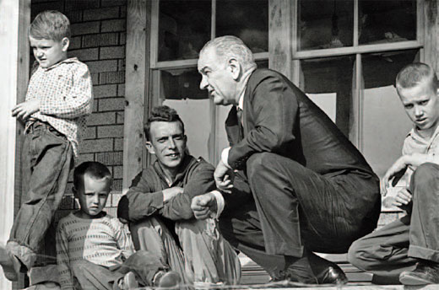
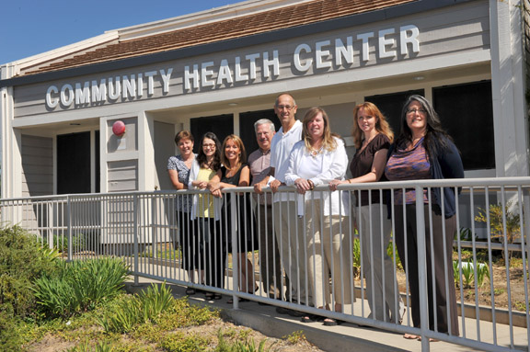
Rural disparities/challenges
Rural Health Clinics – Social Security Act
Community Health Centers, created in the War on Poverty.
Rural disparities still grave.
Serve more challenging populations: language, cultural issues. Delayed care - - sicker populations.

Slide 9
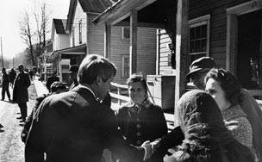
Nearly a half century later, extreme problems persist…
Owsley County is a county located in the Eastern Coalfield region of Kentucky. As of 2010, the population was 4,755. According to the 2010 Census reports, Owsley County is the "poorest county in the United States.”
Robert F. Kennedy famed poverty tour highlighted the malnutrition of eastern Kentucky (field hearings on hunger).
His tour was not unique: his brother John had planned to come in December of 1963, Johnson came in 1964 and, in later years, Nixon, Ted Kennedy, Bill Clinton, Paul Wellstone,
and John Edwards all conducted "poverty tours" that included eastern Kentucky.

Slide 10
Death by Zip Code
University of Washington Study, July 2013
Largest report on status of America’s health in 15 yrs.
Health equates to wealth
The study found that people who live in wealthy areas like San Francisco, Colorado, or the suburbs of Washington, D.C. are likely to be as healthy as their counterparts in Switzerland or Japan, but those who live in Appalachia or the rural South are likely to be as unhealthy as people in Algeria or Bangladesh.
For example, women in Marin County, California, where the median household income is $89,605, have the highest life expectancy -- 85 years -- while women in Perry County, Kentucky, with median income $32,538, have the lowest life expectancy – just under 73 years.
Men living in wealthy Fairfax County, Virginia, median income $108,439, have a life expectancy of almost 82 years, while men in nearby McDowell County, West Virginia, where the median household income is $39,550, had the lowest life expectancy in the country – 63.9 years.

Slide 11
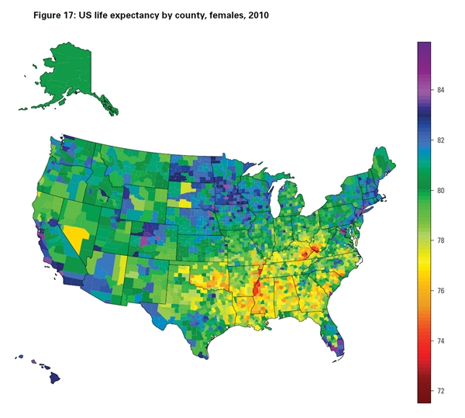

Slide 12
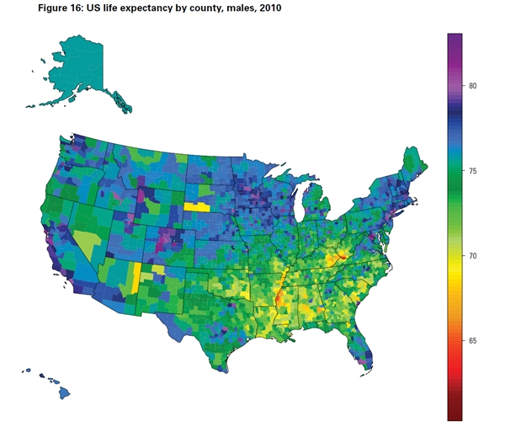

Slide 13
Continuing Resolution
The end of the federal fiscal year is next Monday, September 30
Among other items, Congress must appropriate money for discretionary spending
If they do not, a partial shutdown will ensue

Slide 14
Continuing Resolution
House passed CR that honors the caps set by Budget Control Act of 2011
CR would also mandate defunding the ACA
Rural health program funding continued at current levels, under caps

Slide 15
Continuing Resolution
What happens if a CR isn’t signed into law?
“Non-essential” government operations will cease
This includes sending grant checks, operating federal buildings, etc.
Mandatory spending (Medicare, VA) will continue.

Slide 16
Other issues at end of FY 13
In addition to a CR, two critical rural hospital provisions will expire at the end of FY 13—MDH and LVH
Bills introduced to extend
NRHA continues to advocate for immediate extension to avoid service interruption and fiscal planning.

Slide 17
MDH—LVH Continued
What happens in the programs expire?
Congress would revisit these programs with other extenders set to expire at the end of calendar year
Payments likely made retroactive

Slide 18
Reminder: What does the OIG report say?
HHS Report Would Create Huge Voids in Access to Health Care in Rural America.
The 34-page report of Critical Access Hospitals would eradicate individual state determinations on which small, rural hospitals are critical “necessary providers” in a state;
Would kill rural health care by shutting as many as 70, 80, even over 90% of rural hospitals in a state.
Critical Access Hospitals are critical to the rural economy.
Critical Access Hospitals create approximately 138,000 jobs.
Critical Access Hospitals are often the largest or second largest employer in a rural community.
The average CAH creates 107 jobs and generates $4.8 million in payroll annually and can mean as much as 20% of a rural economy.
The HHS report is wrong. Eliminating Critical Access Hospital does not save money. CAHs save tax payer dollars.
Despite Critical Access Hospitals representing over 22% of all community hospitals, Medicare expenditures to CAHs are less than 5% of the Medicare hospital budget.

Slide 19
NRHA RESPONSE
Swift and immediate to all major health publications and news outlets
Grassroots coordinated campaign to members and states
Resources on website
Excellent work of states
Capitol Hill Advocacy
Hill Strategy
Immediate efforts by our champions

Slide 20
NRHA Response
Staff has met with Finance and Ways and Means in person and electronically
Numerous states have sent “Delegation Letters” to HHS
Ask your Representative to sign onto HR 356: “Rural Hospitals Are Essential” sponsored by Lynn Jenkins

Slide 21
STRATEGY Save our Rural Hospitals
Get involved
Get community/county involved
Our unified message to Congress…
CRITICAL ACCESS HOSPITALS:
1. Protects patients;
2. Protects the rural economy; and
3. Protects taxpayers

Slide 22
STAY INVOLVED
Ways and Means and Finance have indicated that they will meet with OIG to discuss the report
While no legislation currently circulating, the report is being talked about
We MUST lay foundation NOW so when legislation is introduced, we are ready

Slide 23
Affirmative Rural Health Legislation
S. 596: Fostering Independence Through Technology
S.328 Strengthening Rural Access to Emergency Services Act
S.R. 26: Senate Resolution on importance of rural health providers
S. 239: Extension of the FESC Demonstration
H.R. 635: HEALTHY Vets Act of 2013
S. 616: Conrad State 30 and Physician Access Act
H.R. 356 Rural Hospitals are Essential

Slide 24
Rural Health Clinic Legislation
H.R.3458
(1) Extend Medicare electronic health record incentives to eligible professionals practicing in rural health clinics, and (2) Extend Medicare quality reporting incentives to such clinics.
House has 24 cosponsors/Scores at zero.
HR 3849, S. 1680 – R-HoPE
HR 1157, S.643 - - HIT Fix ACT
Allows Rural health Clinics and FQHCs to be eligible for Medicaid EHR incentives

Slide 25
ACA Provisions
Federal Update

Slide 26
Timeline
--Less than 1 Week from now enrollment period for state-based exchanges (marketplaces) will open.
--12 Weeks from then (Jan. 1, 2014) coverage will begin
--That same day (Jan. 1, 2014) Medicaid expansion will occur in majority of states.
--By Jan. 1, 2014, less than 3 months from now, 35-50 Million more people in the U.S. will have health insurance.

Slide 27
Implications
--Demand
--Cost
--Quality
Experts estimate we will need 30,000 more physicians in just 24 months to keep up with demand.

Slide 28
Essential Community Providers
(ECP)
Qualified Health Plans (QHP)
--Marketplace (exchanges) start Jan. 2014
--must include sufficient numbers of ECP’s
--CMS will monitor QHP’s for network adequacy and ECP sufficiency
--Federal and State Marketplaces will use non-exhaustive database of ECP’s.
-- http://cciio.cms.gov

Slide 29
Essential Health Benefits
Outpatient services
Emergency Services
Hospitalization
Maternity, newborn and pediatric care
Mental health/substance abuse care
Rx and lab services
Rehabilitative care
Prevention, wellness and disease management
Different than “minimal essential coverage”

Slide 30
Exchange Cost-Sharing Subsidies
100-150% FPL 94% of charges
150-200% FPL 87% of charges
200-250% FPL 73% of charges
250-400% FPL 70% of charges

Slide 31
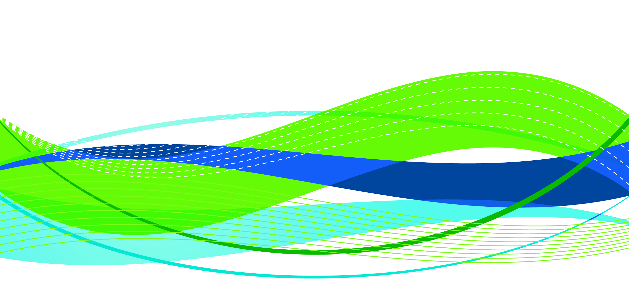
Rural Relevance Under Healthcare Reform Study
ACO Shared Savings (Medicare Beneficiaries)
Approximately $2.2 billion in annual cost differential (savings) occurred in 2010 because the average cost per rural beneficiary was 3.7% lower than the average cost per urban beneficiary,
Approximately $7.2 billion in annual savings to Medicare alone if the average cost per urban beneficiary were equal to the average cost per rural beneficiary,
Approximately $9.4 billion per year is the existing and potential differential between Medicare beneficiary payments for rural vs. urban including the opportunity for savings if all urban populations could be treated at the rural equivalent
© Copyright 2012 iVantage Health Analytics, Inc. www.iVantageHealth.com

Slide 32
Health Care Critical to Rural Economy
Health care is the fastest growing segment of rural economy.
Each rural physician generates 23 jobs in the local rural economy.
Health care often represent up to 20 percent of a rural community's employment and income.

Slide 33
THANK YOU
Brock Slabach, MPH, FACHE
Senior Vice President for Member Services
National Rural Health Association
bslabach@nrharural.org

